Slide 1
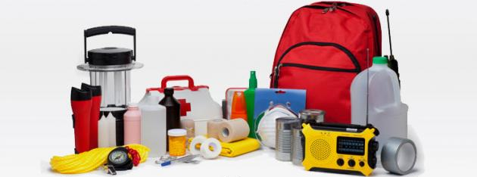
Cooperative Extension & Disasters
Lindsey Haynes-Maslow, PhD, MHA
Associate Professor & Extension Specialist
Department of Agricultural & Human Sciences
NC State University

Slide 2
What is Cooperative Extension?
Cooperative Extension is an organizational entity associated with the USDA and the Land Grant University (LGU) system
Smith-Lever Act of 1914: Cooperative Extension to work with LGUs to provide information about agriculture and home economics to the American public
US has 74 land-grant institutions and 3,150 county administrative office (where local Extension professionals work)
Cooperative Extension is supported by county, state, and federal funds
Department of Agricultural and Human Sciences

Slide 3
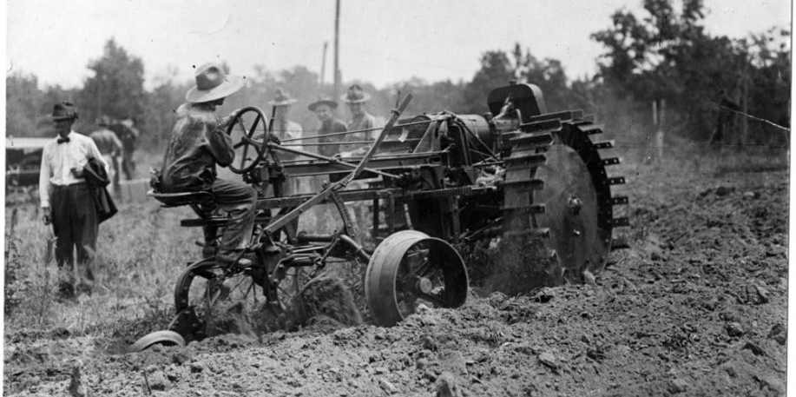
Cooperative Extension & Disasters: Historical Role
Extension became involved in emergency food assistance efforts during World War I
Emergency Food Agents worked to increase local food production, including field crops, milk, and poultry production for the war effort
Department of Agricultural and Human Sciences

Slide 4
Cooperative Extension & Disasters: Historical Role
Extension agents were involved with disaster preparedness, response, and recovery during the Great Depression
Department of Agricultural and Human Sciences

Slide 5
Cooperative Extension & Disasters: Modern Role
Cooperative Extension has been involved in disaster work in every decade since World War II:
Food preservation
Food safety
Food resource management
Nutrition education
Agricultural education
Home safety
Department of Agricultural and Human Sciences

Slide 6
Cooperative Extension during COVID-19
During the COVID-19 pandemic
Free online educational resources
Virtual programming and technical assistance
Penn State supplemented in-person seminars, field days, and growers’ meetings with integrated online courses and workshops, web-based event registration, and delivery of digital educational and marketing information
Helping with emergency food distribution sites
Department of Agricultural and Human Sciences

Slide 7
What can Cooperative Extension do during post-pandemic disasters?
Extension professionals work and live in the communities they serve
Can provide TA for individual, family, and community level disaster preparedness, response and recovery
Extension should be encouraged, supported, and trained to improve and/or modernize informational resources through social media channels AND dissemination of research-based resources in local disaster management and recovery efforts
Extension could also be encouraged, supported, and trained to help make geographical, seasonal, cultural, and contextual adaptions in real-time that are relevant to emergent disaster(s)
Department of Agricultural and Human Sciences

