Slide 1
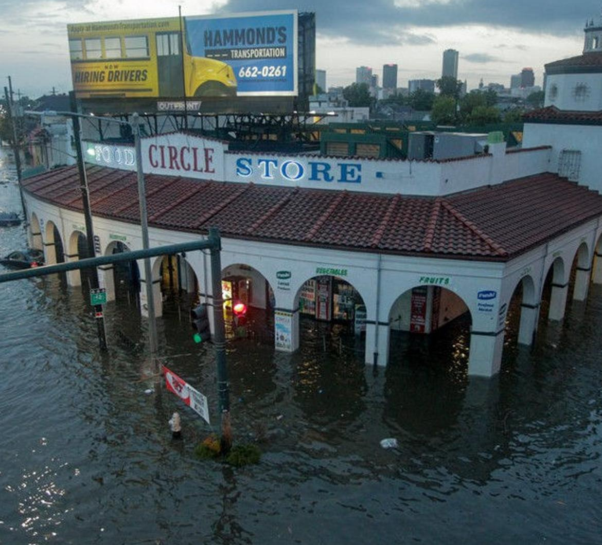
Nutrition Emergencies: Lessons Learned & Opportunities Moving Forward
Notes:
Welcome to Nutrition Emergencies: Lessons Learned and Opportunities Moving Forward.
This session is sponsored by the Society for Nutrition Education and Behavior Advisory Committee on Public Policy.
My name is Sheila Fleischhacker and I have the honor to work with Drs. Lauren Clay, Uri Colon-Ramos, and Lindsey Haynes-Maslow on developing today’s session.
In addition, we are working together on an under review SNEB position paper on nutrition emergencies, which we will discuss further today.
This session aligns well with this year’s conference theme – Raising Reliance and Resilience.
Today’s session is also very relevant to the history and current challenges of our host city, New Orleans.

Slide 2
SNEB 2019 Annual Conference
Session Panelists
Southern Baptist Disaster Relief
Eddie Blackmon
University of Florida Extension Team
Wendy Lynch
LuAnn Duncan
Kendra Zamojski
Linda Bobroff
United States Department of Agriculture
Steve Hortin
TusaRebecca Pannucci
Cora Russell
National WIC Association
Brian Dittmeier
Moderator
Sheila Fleischhacker
SESSION TITLE
Emergency Nutrition: Historical and Contemporary Roles of Nutrition Educators in Natural Disasters and Other Emerging Food System Disruptions
https://www.sneb.org/2019-conference-material/
Notes:
Today’s session builds on the 2019 SNEB session entitled –
Emergency Nutrition: Historical and Contemporary Roles of Nutrition Educators in Natural Disasters and Other Emerging Food System Disruptions
After hearing from our outstanding panelists and attendees, I proposed an SNEB position paper on nutrition emergencies in the fall of 2020.

Slide 3
DRAFT Position of the Society for Nutrition Education and Behavior: Prioritizing Nutrition Security Before, During and After Natural Disasters
It is the position of the Society for Nutrition Education and Behavior (SNEB) that individuals and communities must have access to safe, nutritious, and culturally and contextually appropriate foods and beverages, and receive emergency-related food and nutrition education before, during and after a natural disaster, among other humanitarian emergencies.
Fleischhacker S, Clay L, Colon-Ramos U, Haynes-Maslow L. J Nutr Educ Behav. Under Review
Notes:
Today, about two years later, we have a DRAFT position paper that is entitled –
The DRAFT position statement is as follows –
SNEB members had the opportunity earlier this year to review a draft of this position paper.
We are working with the Journal for Nutrition Education and Behavior to revise our draft in response to peer review.
Hopefully, we will know more when we are live in August about a publication timeline!

Slide 4
Nutrition Security
Having consistent access, availability, and affordability of foods and beverages that promote well-being and prevent (and if needed, treat) disease, particularly among our nation’s most socially disadvantaged populations.
Mozaffarian D, Fleischhacker S, Andres JR. JAMA. 2021;325(16):1605-1606
Food security means “when all people at all times have access to sufficient, safe, nutritious food to maintain a healthy and active life.”
The World Food Summit of 1996
Notes:
Proposed in fall 2020, this position paper has evolved while being written during a pandemic.
One change has been to prioritize nutrition security, which means….
A key difference between nutrition security and food security is that nutrition security more explicitly recognizes the need to promote well-being and prevent (and if needed, treat) disease, particularly among our nation’s most socially disadvantaged populations.

Slide 5
SNEB Position Paper DRAFT Outline
Examines how to prioritize nutrition security before, during and after natural disasters in the United States; specifically, providing an overview of:
Disasters in the US and their intersections with food system disruptions and food insecurity
US disaster response and recovery, with an emphasis on:
The role of the federal nutrition safety net and other non-government sectors’ historical and emerging efforts to prioritize nutrition security and foster resilient food systems
The federal nutrition assistance adaptations during the COVID-19 pandemic
Recommendations are put forth to advance relevant research, policy and practice
Fleischhacker S, Clay L, Colon-Ramos U, Haynes-Maslow L. Position of the Society for Nutrition Education and Behavior: Prioritizing Nutrition Security Before, During and After Natural Disasters. J Nutr Educ Behav. Under Review
Notes:
The DRAFT SNEB position paper on nutrition emergencies….

Slide 6
Objectives
Provide an overview of:
Natural disasters in the US and their intersections with food system disruptions and food insecurity
Lauren Clay, PhD, MPH, Associate Professor, Department of Health Administration and Public Health, D’Youville College
Uriyoan Colon-Ramos, ScD, MPA, Associate Professor, Department of Global Health, George Washington University Milken Institute School of Public Health
Panelist Bios Available at https://raybourn.force.com/SNEB/s/lt-event?id=a1Y1U000003DhqbUAC#/Agenda
Notes:
Today, Lauren and Uri will provide highlights of our overview of natural disasters in the United States and their intersections with food system disruptions and food insecurity.

Slide 7
Objectives
2) US disaster response and recovery, highlighting
The American Red Cross
Laurynn Myers, BA, Manager, National Feeding and Disruption of Emergency Supplies Programs
The Federal Nutrition Safety Net
Ann Hall, MRE, MSS, RDN, LDN, United States Department of Agriculture Food and Nutrition Service, working with Scott Carter, Steve Hortin, TusaRebecca Pannucci & Traci Mouw
Extension
Lindsey Haynes-Maslow, PhD, MHA, Associate Professor & Extension Specialist, Department of Agricultural and Human Sciences, North Carolina State University
World Central Kitchen
Allison Sosna, MPH, Director of Nutrition
Panelist Bios Available at https://raybourn.force.com/SNEB/s/lt-event?id=a1Y1U000003DhqbUAC#/Agenda
Notes:
For the overview of the US disaster response and recovery, you will hear from Laurynn Myers, from the American Red Cross; Ann Hall from the United States Department of Agriculture, and Allison Sosna, from the World Central Kitchen.
These panelists are not co-authors on the SNEB position paper nor should their participation in this session be viewed as an endorsement of the position paper.
Uri, Lauren, Lindsey and I believed for today’s purposes hearing directly from key stakeholders in the US disaster response and recovery would be optimal.
Lindsey will provide an overview of the role of Extension.

Slide 8
Objectives
Provide an overview of:
1) Natural disasters in the US and their intersections with food system
2) US disaster response and recovery
3) SNEB’s under review nutrition emergencies position paper’s recommendations
During Town Hall portion:
Provide key takeaways at the Society and individual attendee level
Discuss and elaborate on key issues and opportunities
Answer attendees Questions
Share key resources
Panelist Bios Available at https://raybourn.force.com/SNEB/s/lt-event?id=a1Y1U000003DhqbUAC#/Agenda
Notes:
After the panelists’ overviews, we will briefly highlight some of the recommendations put forth in the SNEB position paper for research, policy and practice.
Then, we will transition to our live Town Hall portion where
Thank you for joining us today!
Let’s get started with Lauren and Uri’s overview.

Slide 9
Position of the Society for Nutrition Education and Behavior: Prioritizing Nutrition Security Before, During and After Natural Disasters in the United States
Notes:
I am so grateful for our panelists’ collaborative spirit in developing today’s session and each of their individual and organizational efforts to address food insecurity during natural disasters.
Without question, disasters are increasing in both intensity and frequency and often disrupt food systems and increase food insecurity, particularly among socially disadvantaged populations.

Slide 10
DRAFT Position of the Society for Nutrition Education and Behavior: Prioritizing Nutrition Security Before, During and After Natural Disasters
It is the position of the Society for Nutrition Education and Behavior (SNEB) that individuals and communities must have access to safe, nutritious, and culturally and contextually appropriate foods and beverages, and receive emergency-related food and nutrition education before, during and after a natural disaster, among other humanitarian emergencies.
Fleischhacker S, Clay L, Colon-Ramos U, Haynes-Maslow L. J Nutr Educ Behav. Under Review
Notes:
To advance the SNEB proposed position shared earlier today that disaster impacted individuals and communities have access to safe, nutritious, and culturally and contextually appropriate foods and beverages, and receive emergency-related food and nutrition education before, during and after disasters, the following nine recommendations have been put forth in the DRAFT SNEB nutrition emergencies position paper:

Slide 11
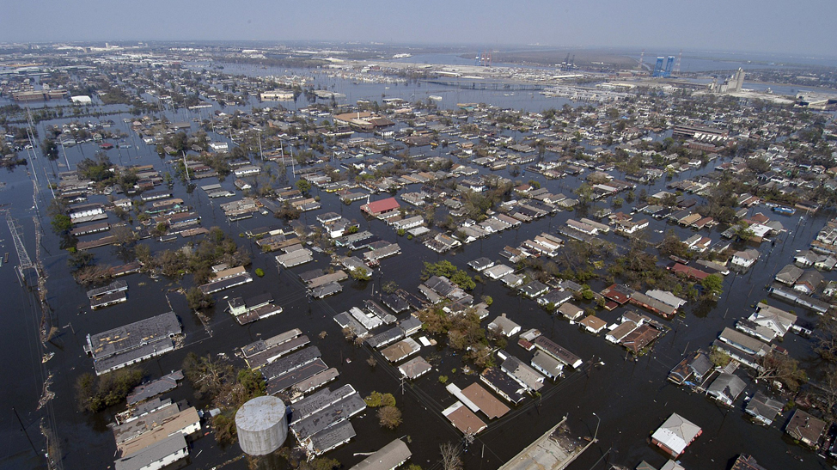
Invest in infrastructure that can help eliminate and/or mitigate the inequitable impacts of disasters and can foster a more resilient food system
Fleischhacker S, Clay L, Colon-Ramos U, Haynes-Maslow L. Position of the Society for Nutrition Education and Behavior: Prioritizing Nutrition Security Before, During and After Natural Disasters. J Nutr Educ Behav. Under Review
Notes:
Invest in infrastructure that can help eliminate and/or mitigate the inequitable impacts of disasters and can foster a more resilient food system.

Slide 12
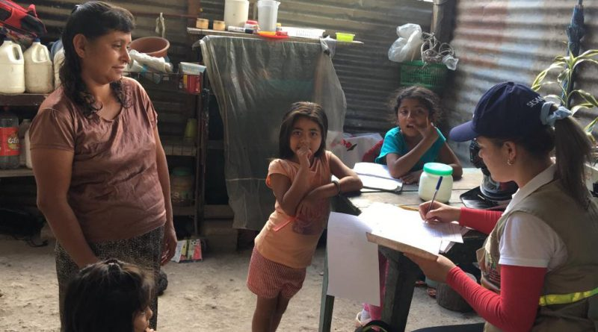
Strengthen our national investments in monitoring and surveillance of emergency needs and feeding actions with particular attention to measures that can be adapted in disaster-affected areas
Fleischhacker S, Clay L, Colon-Ramos U, Haynes-Maslow L. Position of the Society for Nutrition Education and Behavior: Prioritizing Nutrition Security Before, During and After Natural Disasters. J Nutr Educ Behav. Under Review
Notes:
Strengthen our national investments in monitoring and surveillance of emergency needs and feeding actions with particular attention to measures that can be adapted in disaster-affected areas.

Slide 13
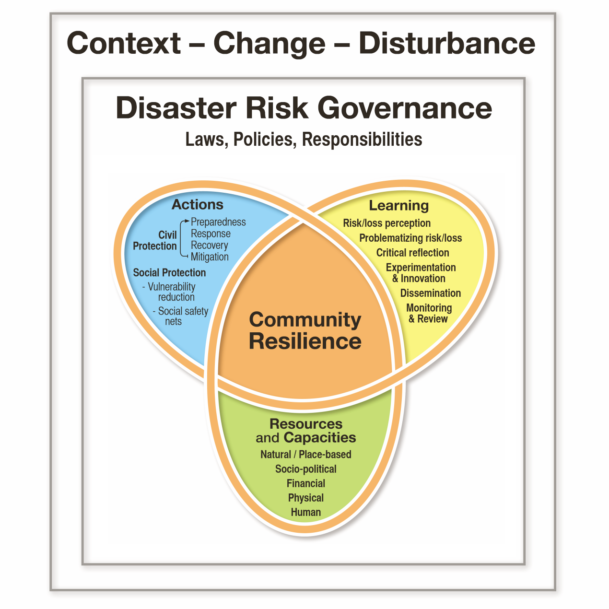
Strengthen our local capacity to address nutrition security before, during and after nutrition disasters
Fleischhacker S, Clay L, Colon-Ramos U, Haynes-Maslow L. Position of the Society for Nutrition Education and Behavior: Prioritizing Nutrition Security Before, During and After Natural Disasters. J Nutr Educ Behav. Under Review
Notes:
Strengthen our local capacity to address nutrition security before, during and after nutrition disasters.

Slide 14
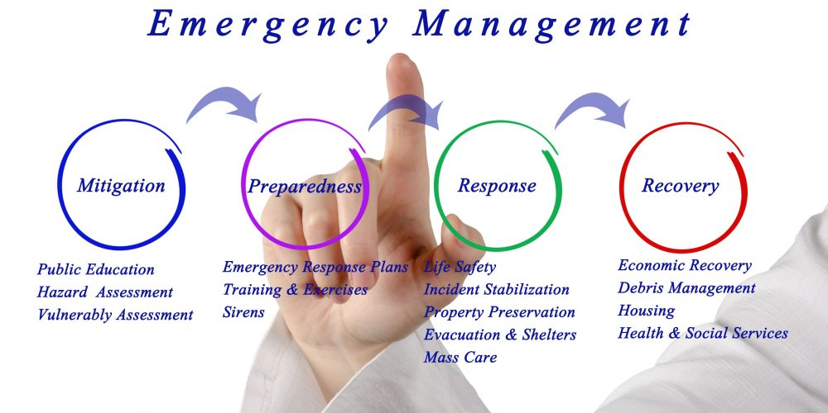
Develop a robust interprofessional disaster management curriculum that includes emergency nutrition curricular components to train the next generation to work together towards shared goals
Fleischhacker S, Clay L, Colon-Ramos U, Haynes-Maslow L. Position of the Society for Nutrition Education and Behavior: Prioritizing Nutrition Security Before, During and After Natural Disasters. J Nutr Educ Behav. Under Review
Notes:
Develop a robust interprofessional disaster management curriculum that includes emergency nutrition curricular components to train the next generation to work together towards shared goals.

Slide 15
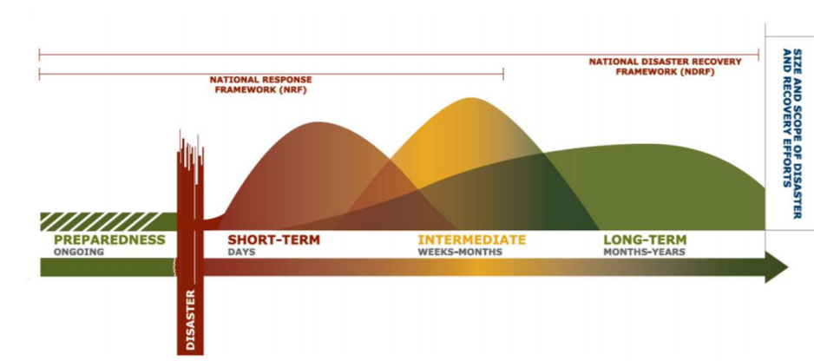
Improve coordination between federal departments and agencies compromising the federal nutrition community, including special attention to emergency food assistance
Fleischhacker S, Clay L, Colon-Ramos U, Haynes-Maslow L. Position of the Society for Nutrition Education and Behavior: Prioritizing Nutrition Security Before, During and After Natural Disasters. J Nutr Educ Behav. Under Review
Notes:
Improve coordination between federal departments and agencies compromising the federal nutrition community, including special attention to emergency food assistance.

Slide 16
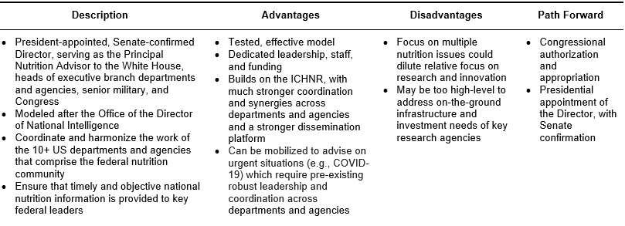
Proposed Office of the National Director of Food and Nutrition
New icon for the new ONDFN
Fleischhacker S et al. Am J Clin Nutr. 2020;112(3):721-769
Notes:
One proposed approach is establishing a new Office of the National Director of Food and Nutrition. This new Office could coordinate across the more than 10 federal departments and agencies that work on nutrition and develop a particular focus on nutrition emergency preparedness and fostering resilient food systems.

Slide 17
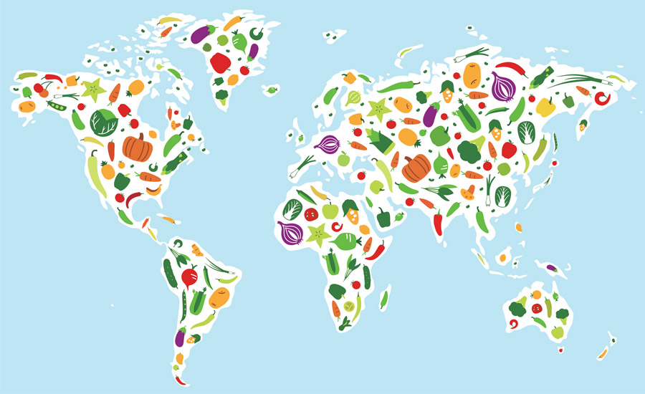
Improve coordination between and among all national governments, levering the role of key international convening organizations, to strengthen food production and distribution systems before, during and after humanitarian emergencies
Fleischhacker S, Clay L, Colon-Ramos U, Haynes-Maslow L. Position of the Society for Nutrition Education and Behavior: Prioritizing Nutrition Security Before, During and After Natural Disasters. J Nutr Educ Behav. Under Review
Notes:
Beyond within country coordination, efforts should be made to improve coordination between and among all national governments, levering the role of key international convening organizations, to strengthen food production and distribution systems before, during and after humanitarian emergencies.

Slide 18
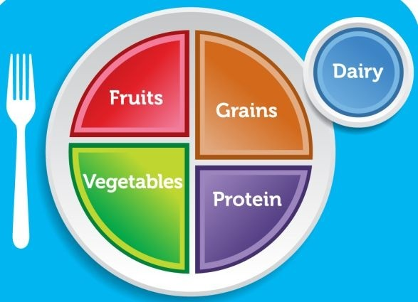
Develop nutrition disaster specific guidelines and specifications to better align with the DGAs
Fleischhacker S, Clay L, Colon-Ramos U, Haynes-Maslow L. Position of the Society for Nutrition Education and Behavior: Prioritizing Nutrition Security Before, During and After Natural Disasters. J Nutr Educ Behav. Under Review
Notes:
Develop nutrition disaster specific guidelines and specifications to better align with the DGAs.

Slide 19
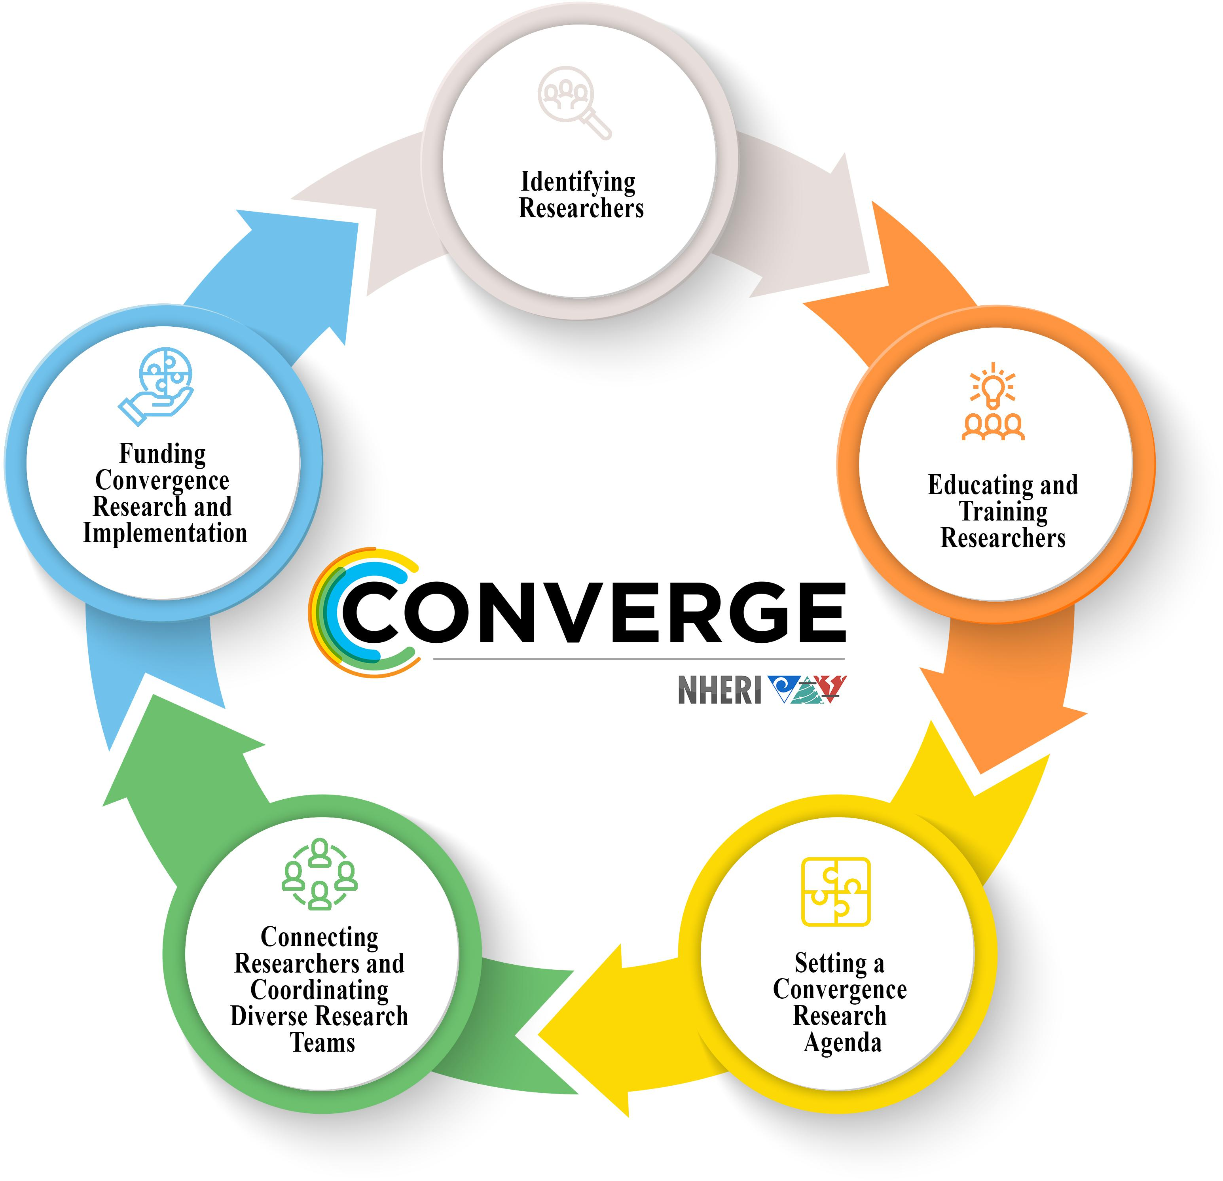
Develop a research agenda and the relevant funding mechanisms needed for strengthening the public health impacts of our federal disaster relief response
Peek L, et al. Front Built Environ. 2020
https://doi.org/10.3389/fbuil.2020.00110
Fleischhacker S, Clay L, Colon-Ramos U, Haynes-Maslow L. Position of the Society for Nutrition Education and Behavior: Prioritizing Nutrition Security Before, During and After Natural Disasters. J Nutr Educ Behav. Under Review
Notes:
Develop a research agenda and the relevant funding mechanisms needed for strengthening the public health impacts of our federal disaster relief response.

Slide 20
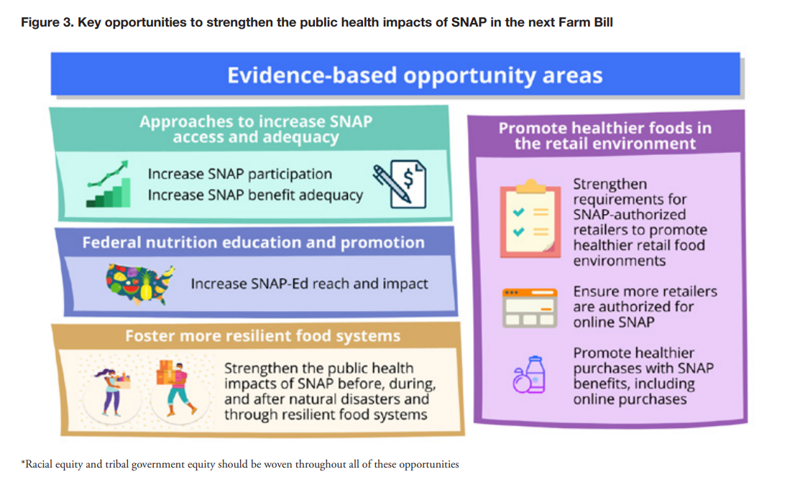
Ensure adequate federal nutrition assistance for all Americans to build resilience during emergencies
Bleich SN, Sullivan K, Broad Leib E, Dunn CG, Woteki C, Yaroch AL, Fleischhacker S. Healthy Eating Research 2021. Available at: healthyeatingresearch.org
Fleischhacker S, Clay L, Colon-Ramos U, Haynes-Maslow L. Position of the Society for Nutrition Education and Behavior: Prioritizing Nutrition Security Before, During and After Natural Disasters. J Nutr Educ Behav. Under Review
Notes:
And last but not least - Ensure adequate federal nutrition assistance for all Americans to build resilience during emergencies.
I highlight here a Healthy Eating Research report on SNAP just out this summer that raises this opportunity up as one approach to strengthen the public health impacts of SNAP in the next Farm Bill.

Slide 21
Nutrition Emergencies: Lessons Learned & Opportunities Moving Forward
Questions – Please email Sheila at sheilafly9@gmail.com
Notes:
In conclusion, more work remains to lift up research, policy, and practice with the greatest potential to more effectively address food and nutrition insecurity before, during and after disasters. This work includes addressing structural racism to mitigate inequities in disaster impacts.
We look forward to discussing lessons learned and opportunities moving forward now during the live town hall.
Thank you for joining us today!

Slide 22
Session Takeaways
Disasters are increasing with intensity and frequency
Often disrupt food systems
Usually increase food insecurity, particularly among socially disadvantaged populations
More work remains to lift up research, policy and practice with the greatest potential to more effectively address food and nutrition insecurity before, during and after disasters and foster resilient food systems
This work includes addressing structural racism to mitigate inequities in disaster impacts
SNEB – as a society and each of its members can help prioritize nutrition security before, during and after disasters

Slide 23
Panelist Discussion Items
Collaborative nature of disaster response and recovery
Coordination
Innovation
Short and long-term needs and opportunities
Resilience
How best SNEB, as a society and its individual members, can engage in this work

Slide 24
Suggested Resources
Ready.gov
FEMA & American Red Cross Food and Water in an Emergency
https://www.redcross.org/content/dam/redcross/atg/PDF_s/Preparedness___Disaster_Recovery/Disaster_Preparedness/Food_Safety/Food_and_Water-English.revised_7-09.pdf
USDA FNS – http://www.fns.usda.gov/disaster
NIFA Funds Disaster Response Efforts - https://nifa.usda.gov/blog/disaster-response
UF IFAS Extension Disaster Preparation and Recovery - http://disaster.ifas.ufl.edu
FRAC Disaster Relief - https://frac.org/hunger-natural-disasters
Pan American Health Organization Food and Nutrition in Disasters
https://www.paho.org/en/health-emergencies/food-and-nutrition-disasters

